Slide 1
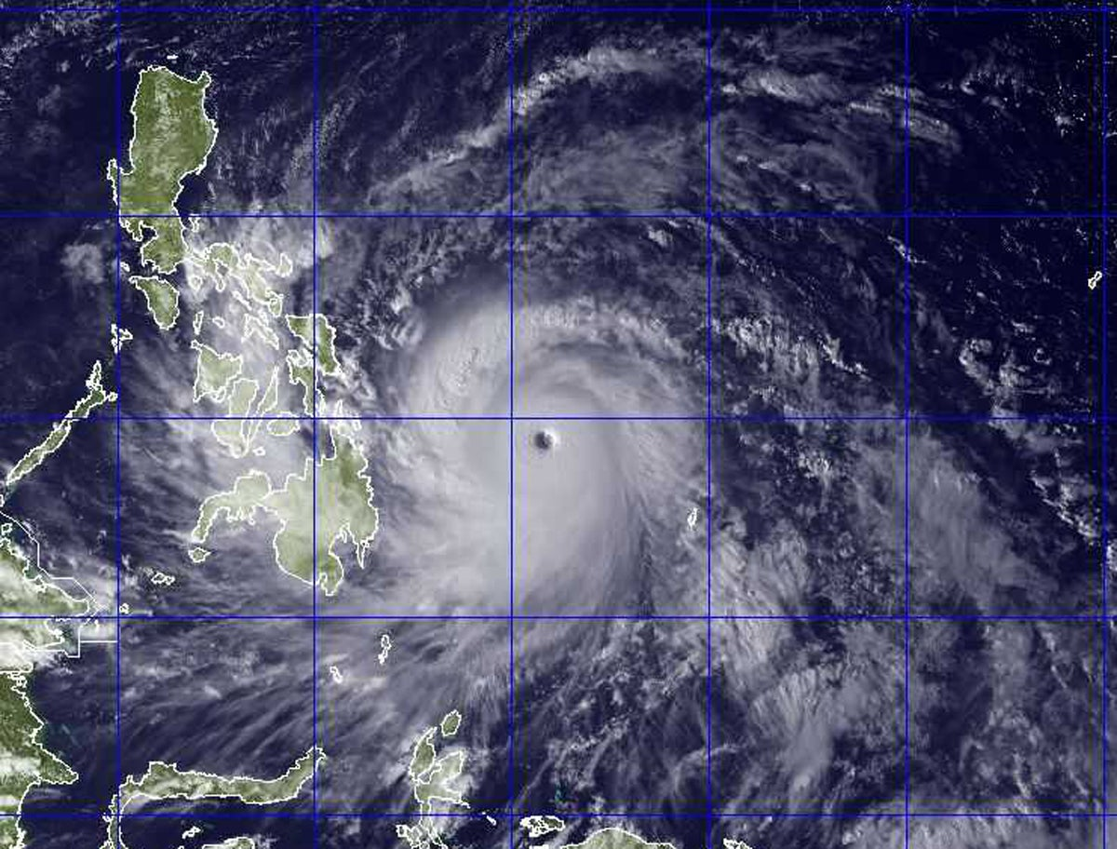
Turbulent flux over land and sea as a Kelvin wave propagates through different phases of the MJO
Crizzia Mielle De Castro

Slide 2
Outline
Introduction
Research Questions
Data and Methods
Results and Discussions
Summary and Conclusions

Slide 3
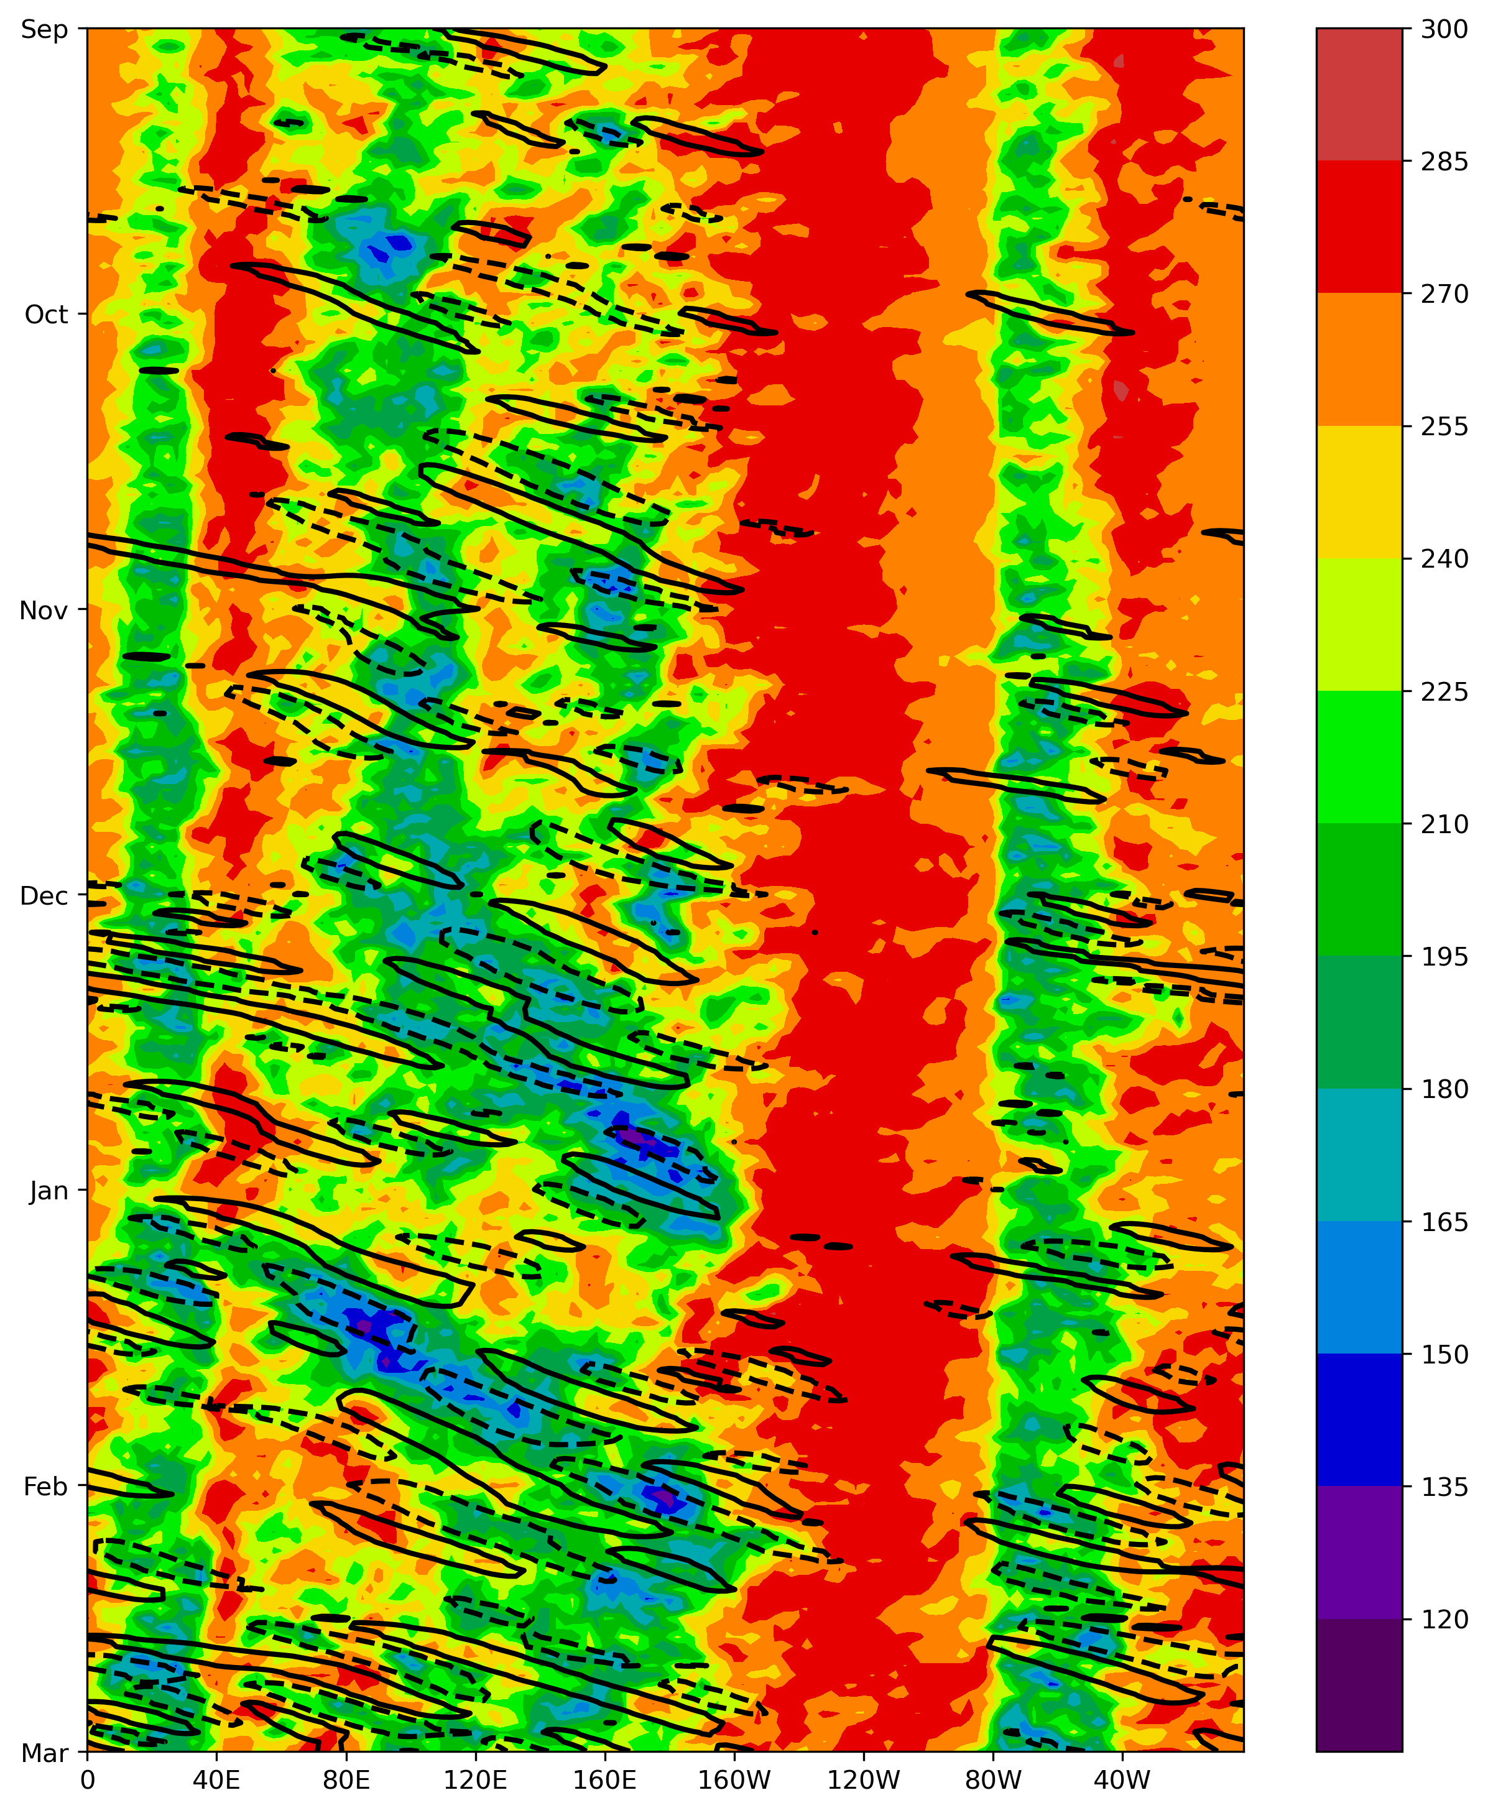
Theoretical background
Kelvin waves
Synoptic scale convective structure (Wallace & Kousky, 1968)
15 day period
Eastward phase speeds 9-20 m/s
3,300-6,000 km horizontal structures
Figure 1. Hovmöller diagram of eastward propagating Kelvin waves (contours) and average overall OLR (shaded)
Introduction Research Questions Data & Methods Results & Discussions Conclusions
Notes:
Equatorial Kelvin waves are fast moving synoptic scale convective disturbances that propagate eastward along the tropics.

Slide 4
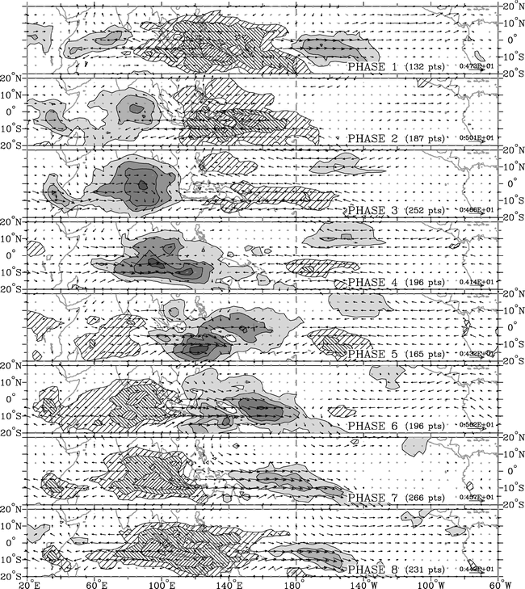
Theoretical background
Madden-Julian Oscillation (MJO)
Planetary scale convective structure (Madden & Julian, 1994)
40-50 day period
Eastward phase speeds 4-8 m/s
10,000 km horizontal structures
Figure 2. Composite OLR (shaded) and 850 𝑚𝑏 wind vector anomalies for 8 RMM phases. Figure from Wheeler and Hendon (2004).
Introduction Research Questions Data & Methods Results & Discussions Conclusions
Notes:
The MJO is a slower moving planetary scale convective disturbance propagating eastward. The MJO roughly follows eight RMM phases, which depends on its location. During phase 3, enhanced over Indian ocean and suppressed over west Pacific. Opposite during phase 7.

Slide 5
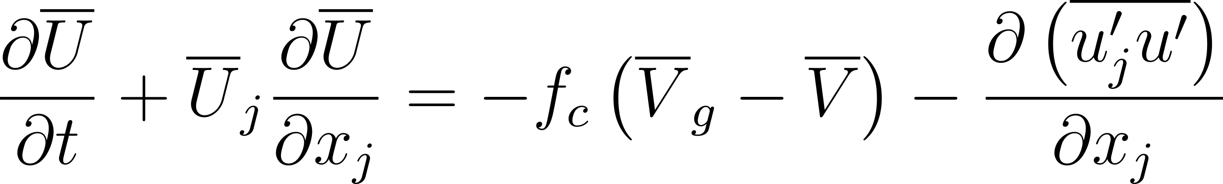
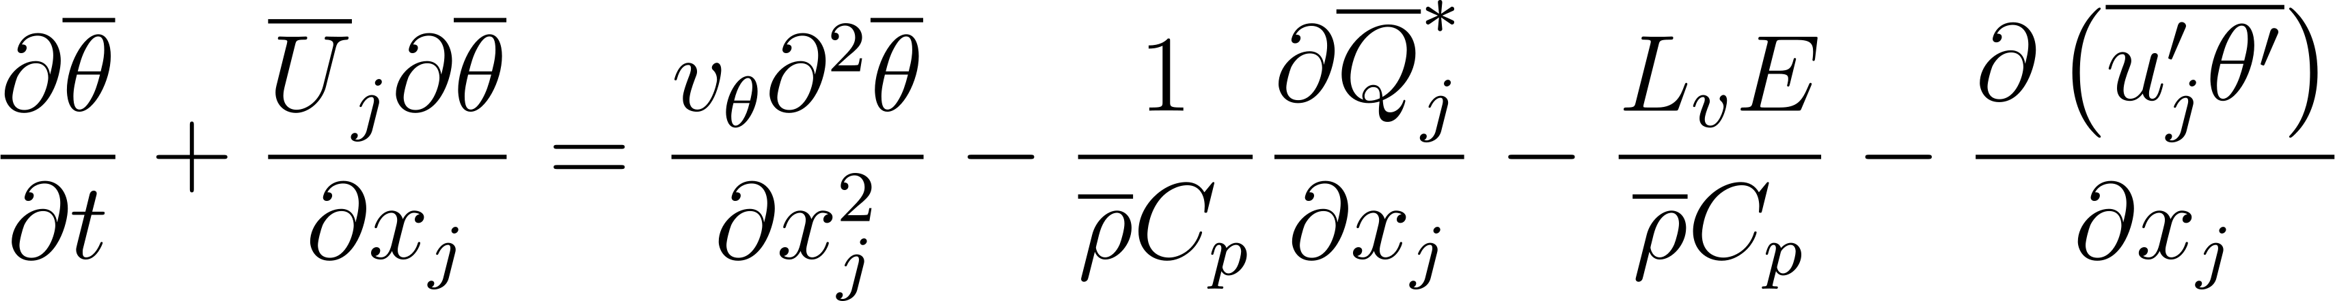
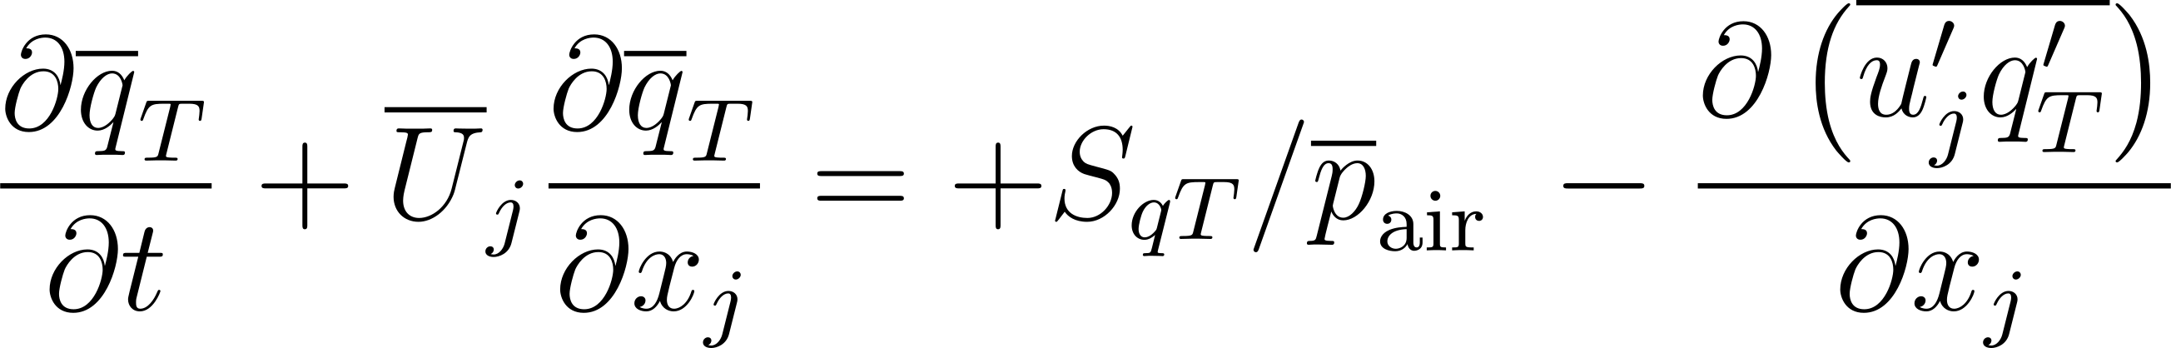
Theoretical background
Equations for Mean Variables in Turbulent Flow
Introduction Research Questions Data & Methods Results & Discussions Conclusions
Notes:
Recall the equations for…

Slide 6
Theoretical background
Equations for Mean Variables in Turbulent Flow
Vertical advection
Introduction Research Questions Data & Methods Results & Discussions Conclusions
Notes:
In my current research, we are looking at vertical advection… when a Kelvin wave propagates through… So to better understand the evolution of advection in the tropics

Slide 7
Theoretical background
Equations for Mean Variables in Turbulent Flow
Vertical turbulent flux
Introduction Research Questions Data & Methods Results & Discussions Conclusions
Notes:
I wanted to look at the… for this project

Slide 8
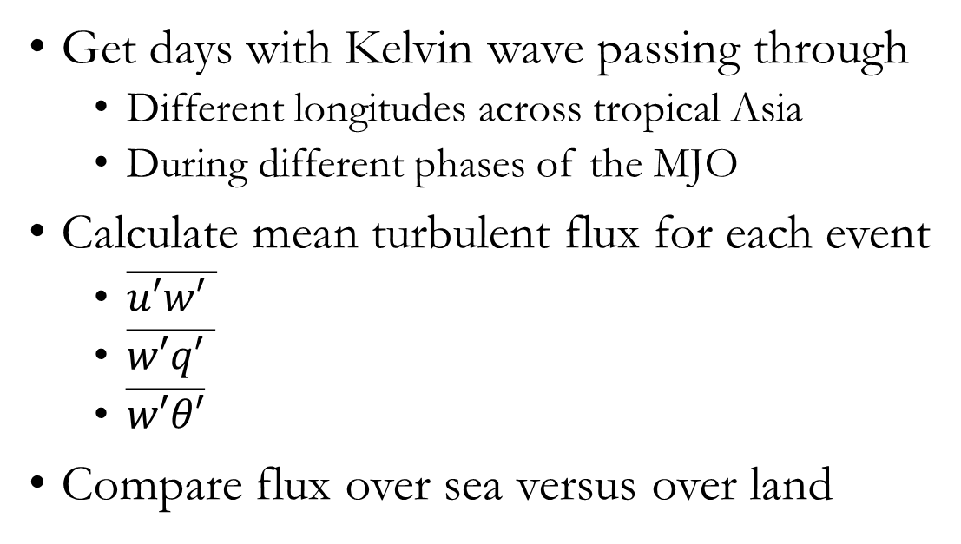
Objectives
Get days with Kelvin wave passing through
Different longitudes across tropical Asia
During different phases of the MJO
Calculate mean turbulent flux for each event
$\overline{u′w′ }$
$\overline{w′q′ }$
$\overline{w′θ′}$
Compare flux over sea versus over land
Introduction Research Questions Data & Methods Results & Discussions Conclusions
Notes:
So, for this study I aimed to…

Slide 9
Research Questions
How do the turbulent fluxes compare during Kelvin wave events over the Indian ocean versus over the Maritime Continent? How does the vertical structure of the turbulent fluxes change over the sea versus over land?
How do the turbulent fluxes change across the different phases of the MJO? How do the turbulent fluxes behave during the active convective phase versus the suppressed convective phase of the MJO?
Introduction Research Questions Data & Methods Results & Discussions Conclusions
Notes:
And I wanted to answer the following questions… I’ll discuss in a bit the methods I used to answer… But first,…

Slide 10
Data
NCEP Reanalysis Data (1979-2020)
Daily mean OLR
2.5º x 2.5º grid
IRI Climate Data Library (1979-2020)
Daily RMM phase data
ERA5 Reanalysis Data (1979-2020)
Daily mean zonal and vertical winds
Daily mean specific humidity
Daily mean temperatures
1º x 1º grid
Pressure levels 1000-800 hPa
Introduction Research Questions Data & Methods Results & Discussions Conclusions
Notes:
Here are the data I used.

Slide 11
Data
NCEP Reanalysis Data (1979-2020)
Daily mean OLR
2.5º x 2.5º grid
IRI Climate Data Library (1979-2020)
Daily RMM phase data
ERA5 Reanalysis Data (1979-2020)
Daily mean zonal and vertical winds
Daily mean specific humidity
Daily mean temperatures
1º x 1º grid
Pressure levels 1000-800 hPa
To find days with Kelvin wave events
To calculate fluxes
Introduction Research Questions Data & Methods Results & Discussions Conclusions
Notes:
I used the outgoing longwave radiation (OLR) as a proxy for convection. I used the daily OLR and RMM phase to find days with Kelvin waves propagating in… Then I used the daily winds, specific humidity, and temperatures from ERA5…

Slide 12
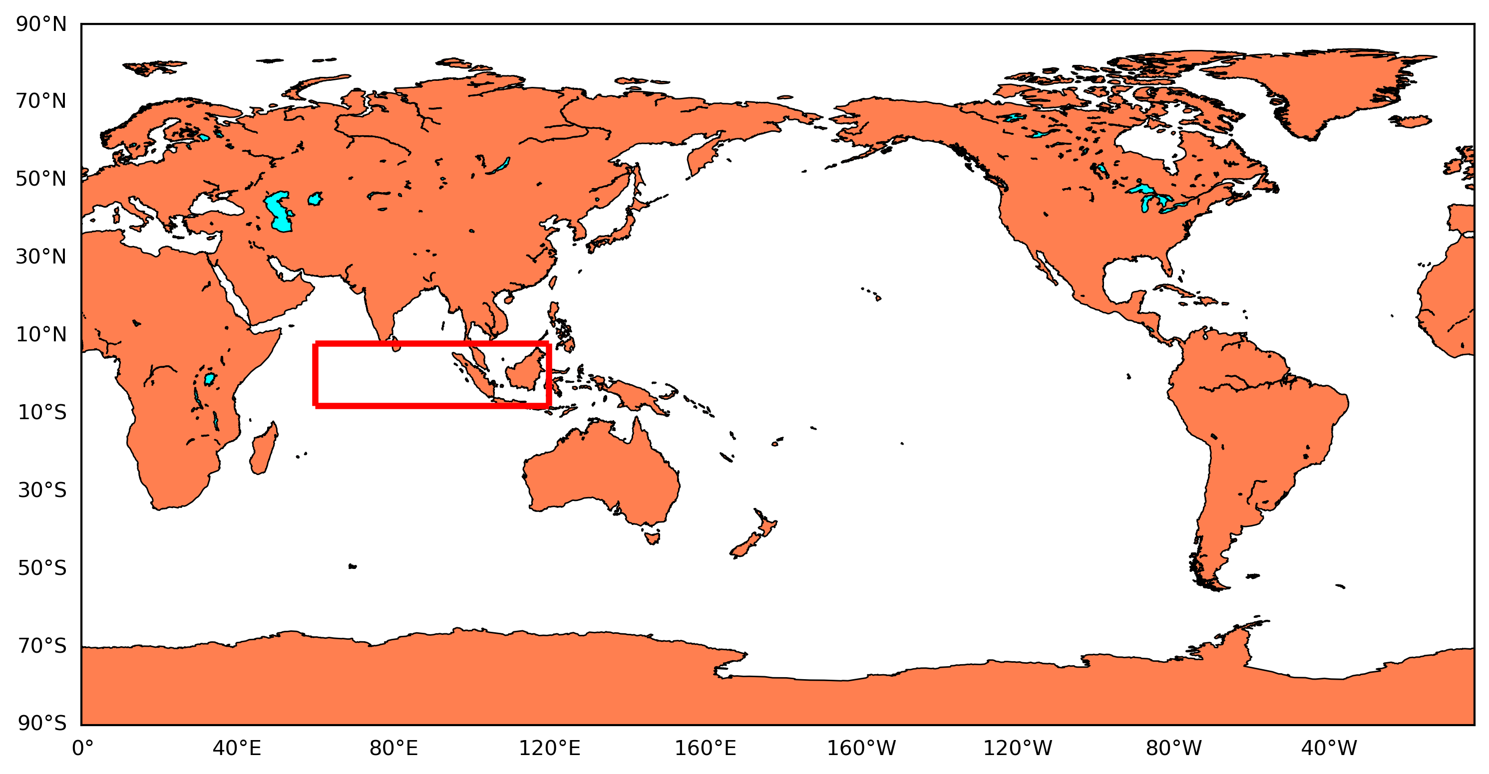
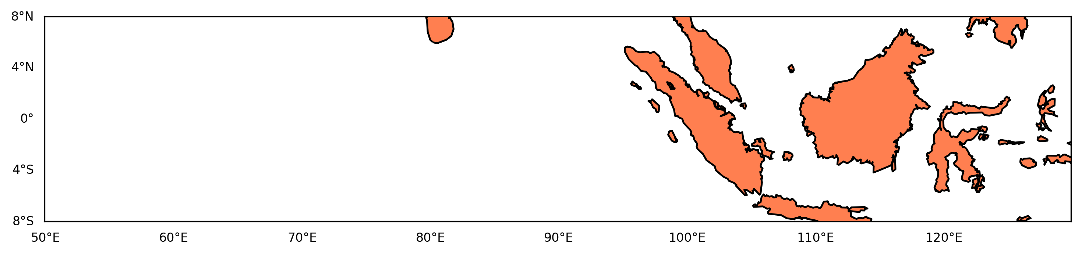
Get days with Kelvin wave events
Apply Fourier filtering to OLR anomalies (Wheeler and Kiladis, 1999)
Find days with strong Kelvin wave events passing through specific base longitudes
Separate days further into each phase of the MJO
Introduction Research Questions Data & Methods Results & Discussions Conclusions
Notes:
To get the days with... I first applied Fourier filtering to… which filters Kelvin waves from other waves. In the interest of time,… From that, I find the days with strong… passing through this boxed section in the tropics, which is from 60E to 120E. Then I separated the days further….

Slide 13
Calculating turbulent fluxes
Remove seasonal cycle and get anomalies of wind, temperature, and specific humidity via regression (Roundy, 2020)
Calculate mean turbulent flux
$$\overline{u′w′ }$$
$$\overline{w′q′ }$$
$$\overline{w′θ′}$$
Calculate mean turbulent flux
(𝑢′𝑤′" " ) ̅
(𝑤′𝑞′" " ) ̅
(𝑤′𝜃′) ̅
Separate into each pair of base longitude and MJO phase of the Kelvin wave events
Introduction Research Questions Data & Methods Results & Discussions Conclusions
Notes:
To calculate the… I first removed the seasonal cycle and got the anomalies of… Again, in the interest of time… Then I calculate following these equations. Lastly, I separated the fluxes into each pair… In the end this should give me the turbulent flux from 1000 hPa to 800 hPa

Slide 14
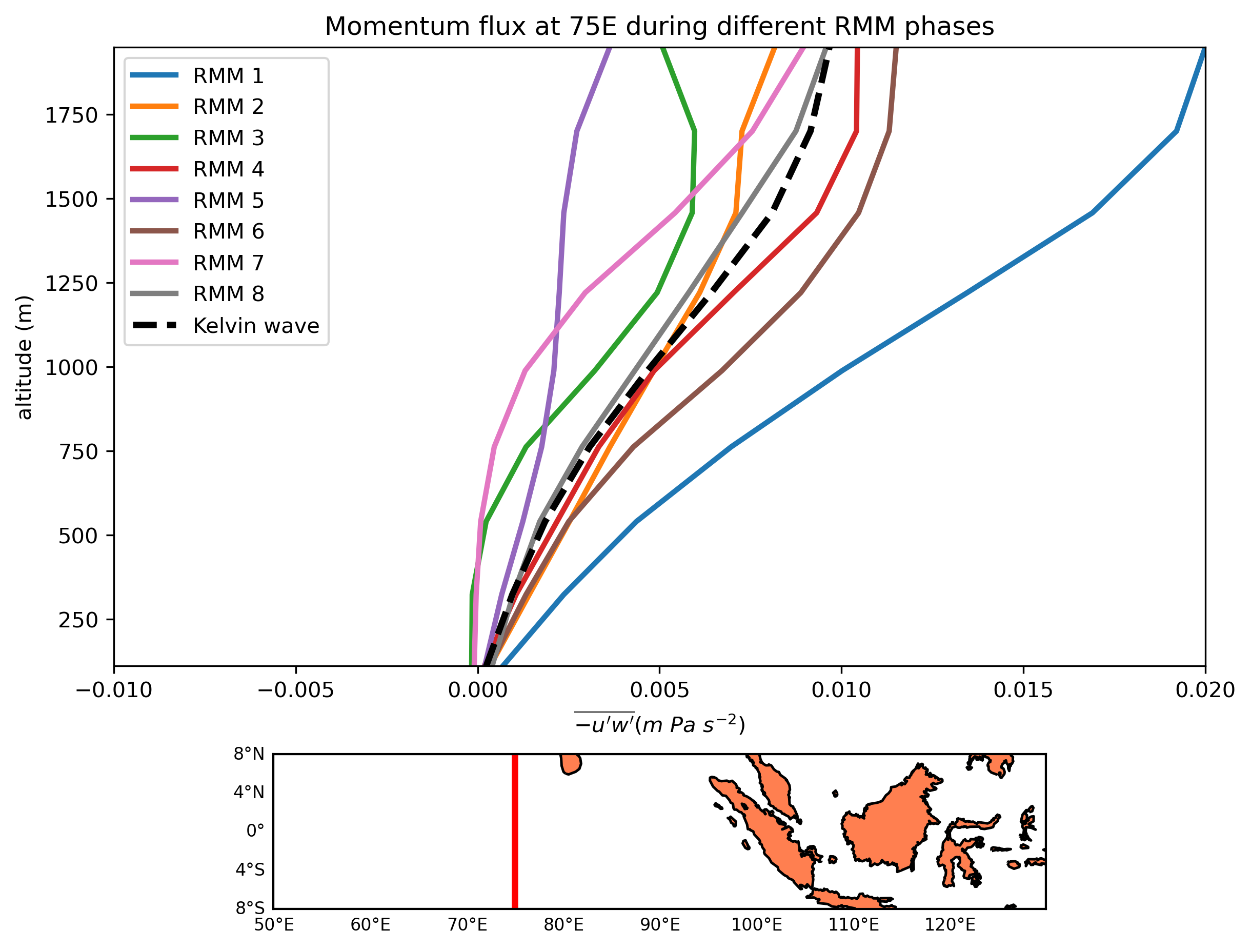
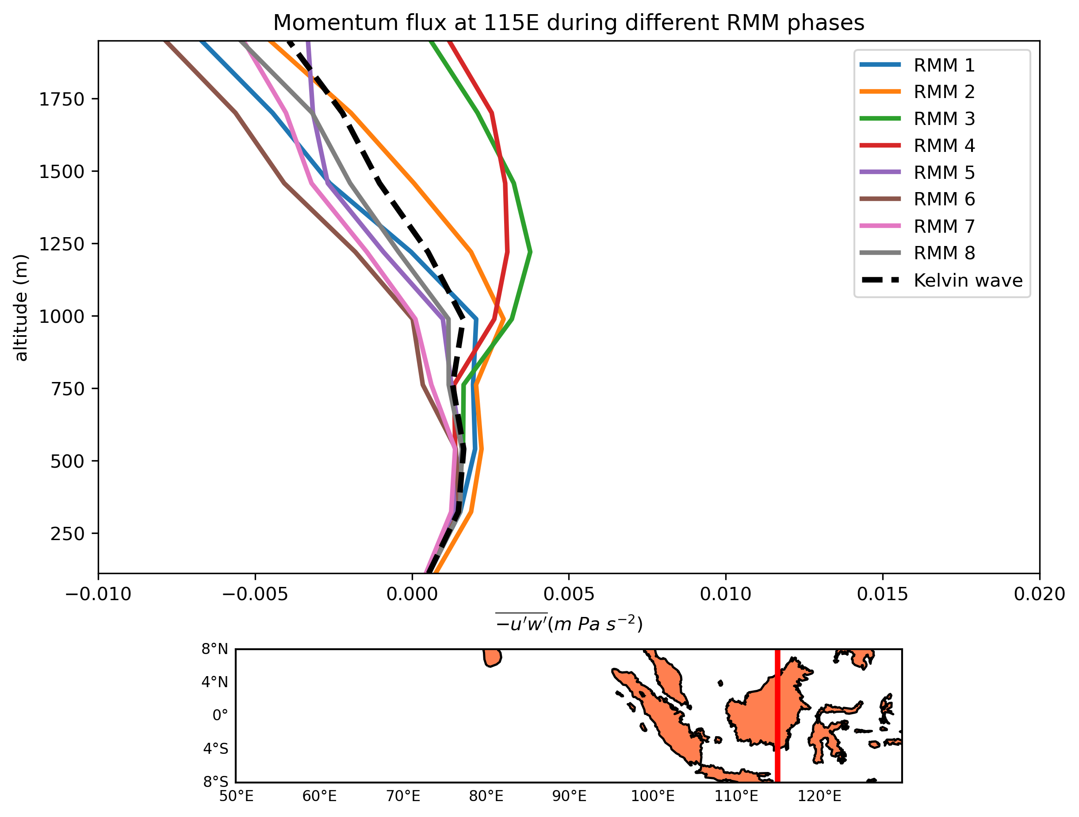
Momentum Flux
Introduction Research Questions Data & Methods Results & Discussions Conclusions
Notes:
More positive over water than land
Over land, weakly positive at BL but becomes more negative above the BL
MJO has little effect on the BL over land
Over water, more positive during RMM 1 and 6 (suppressed convection)
Over land, more positive during RMM 2,3,4 (enhanced convection)

Slide 15
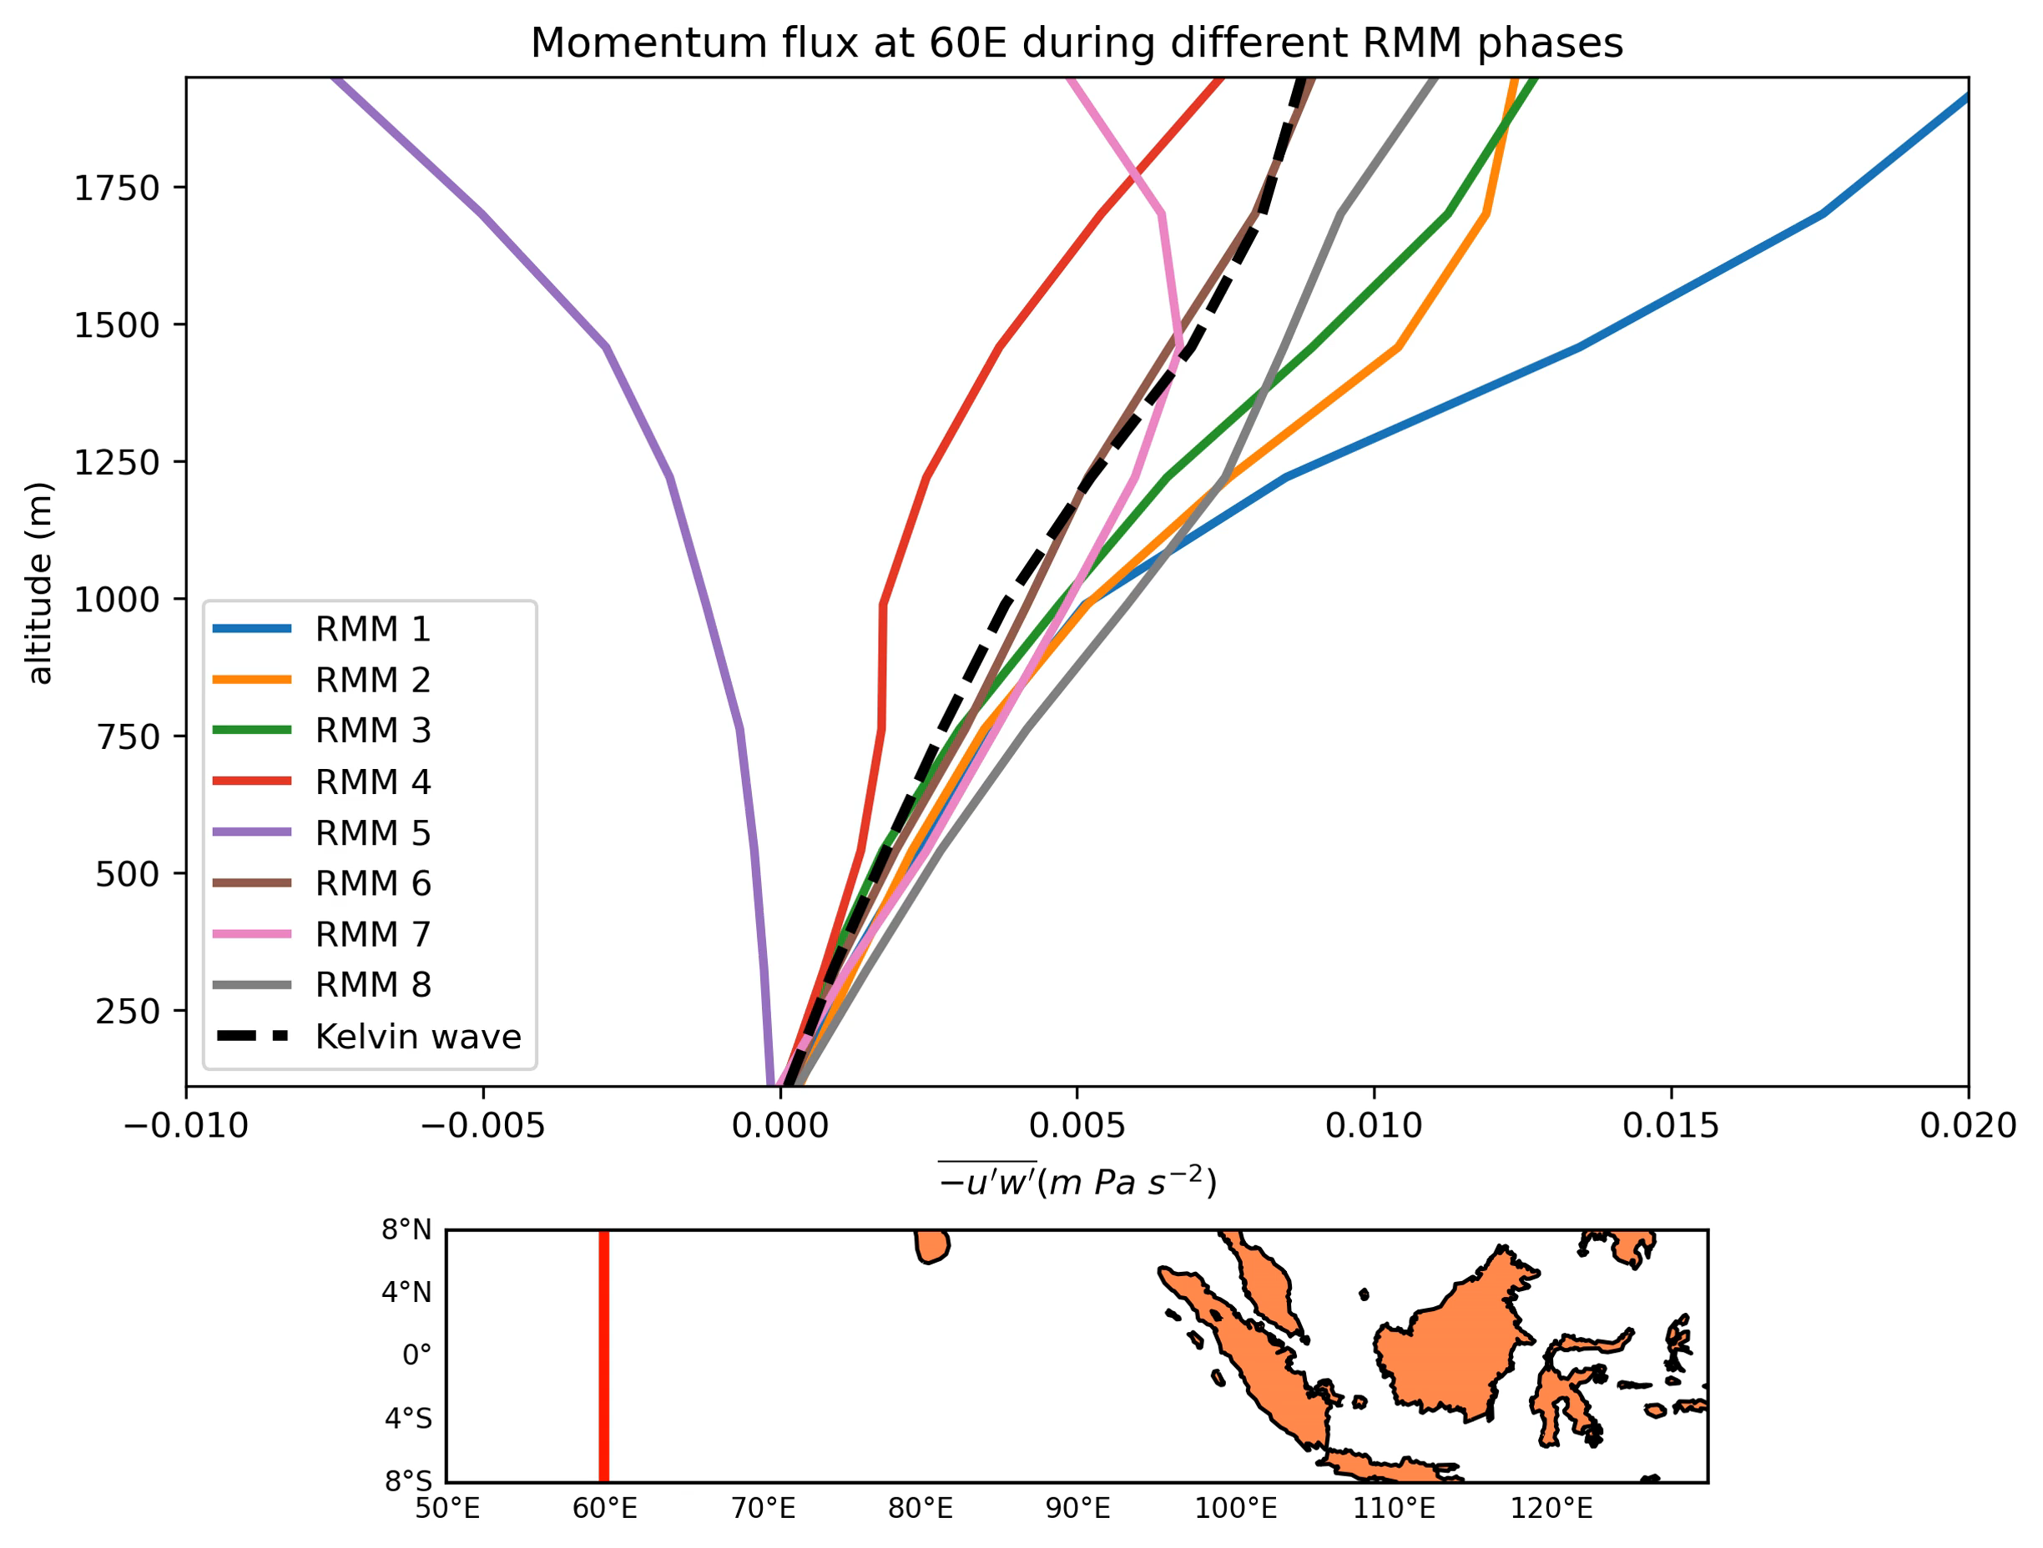
Momentum Flux
Momentum flux is more positive over water than land. The MJO has more evident effects on the boundary layer over water than land.
Introduction Research Questions Data & Methods Results & Discussions Conclusions

Slide 16
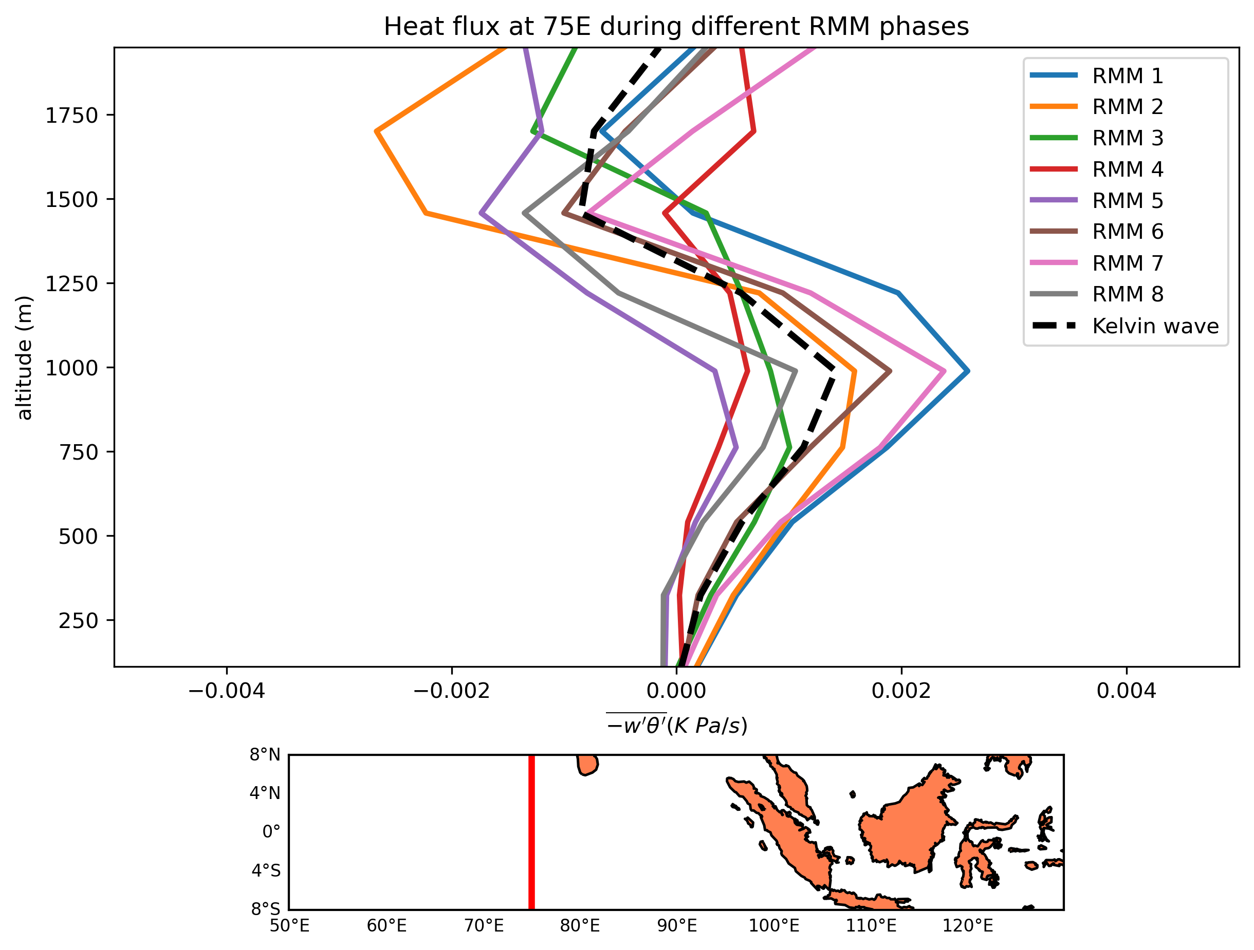
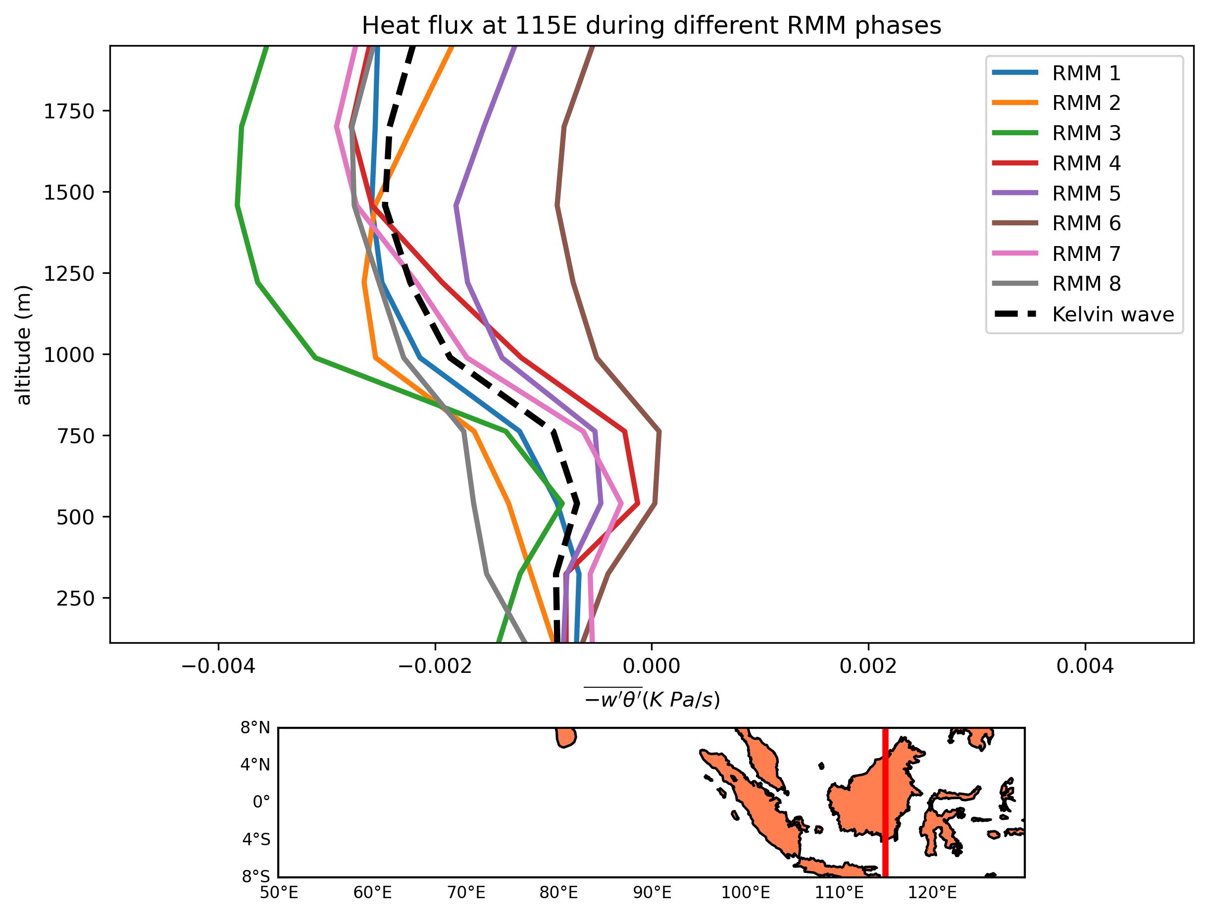
Heat Flux
Introduction Research Questions Data & Methods Results & Discussions Conclusions
Notes:
Inversion at 1000 m and again at 1500 m over water
Inversion at around 600 m over land
Lower inversion height over land than water
More positive during RMM 1,6,7 over water = suppressed convection
More positive during RMM 4,5,6 over land = active convection

Slide 17
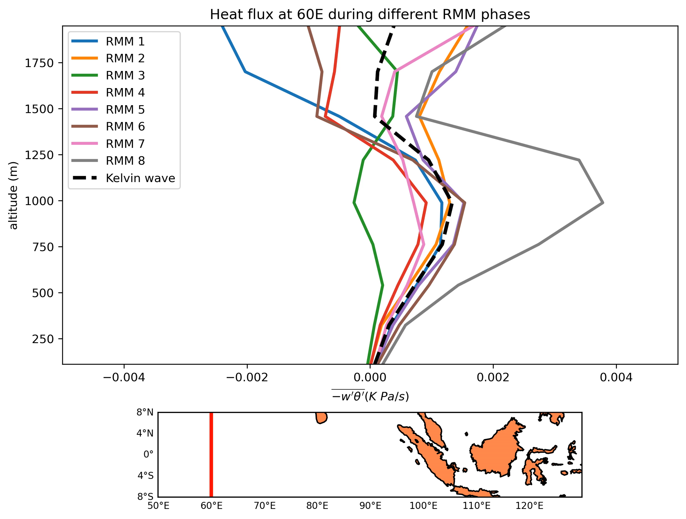
Heat Flux
The inversion of heat flux occurs at a higher altitude over water than land. Heat flux is more positive during the MJO’s suppressed phase over water, and during the enhanced phase over land.
Introduction Research Questions Data & Methods Results & Discussions Conclusions

Slide 18
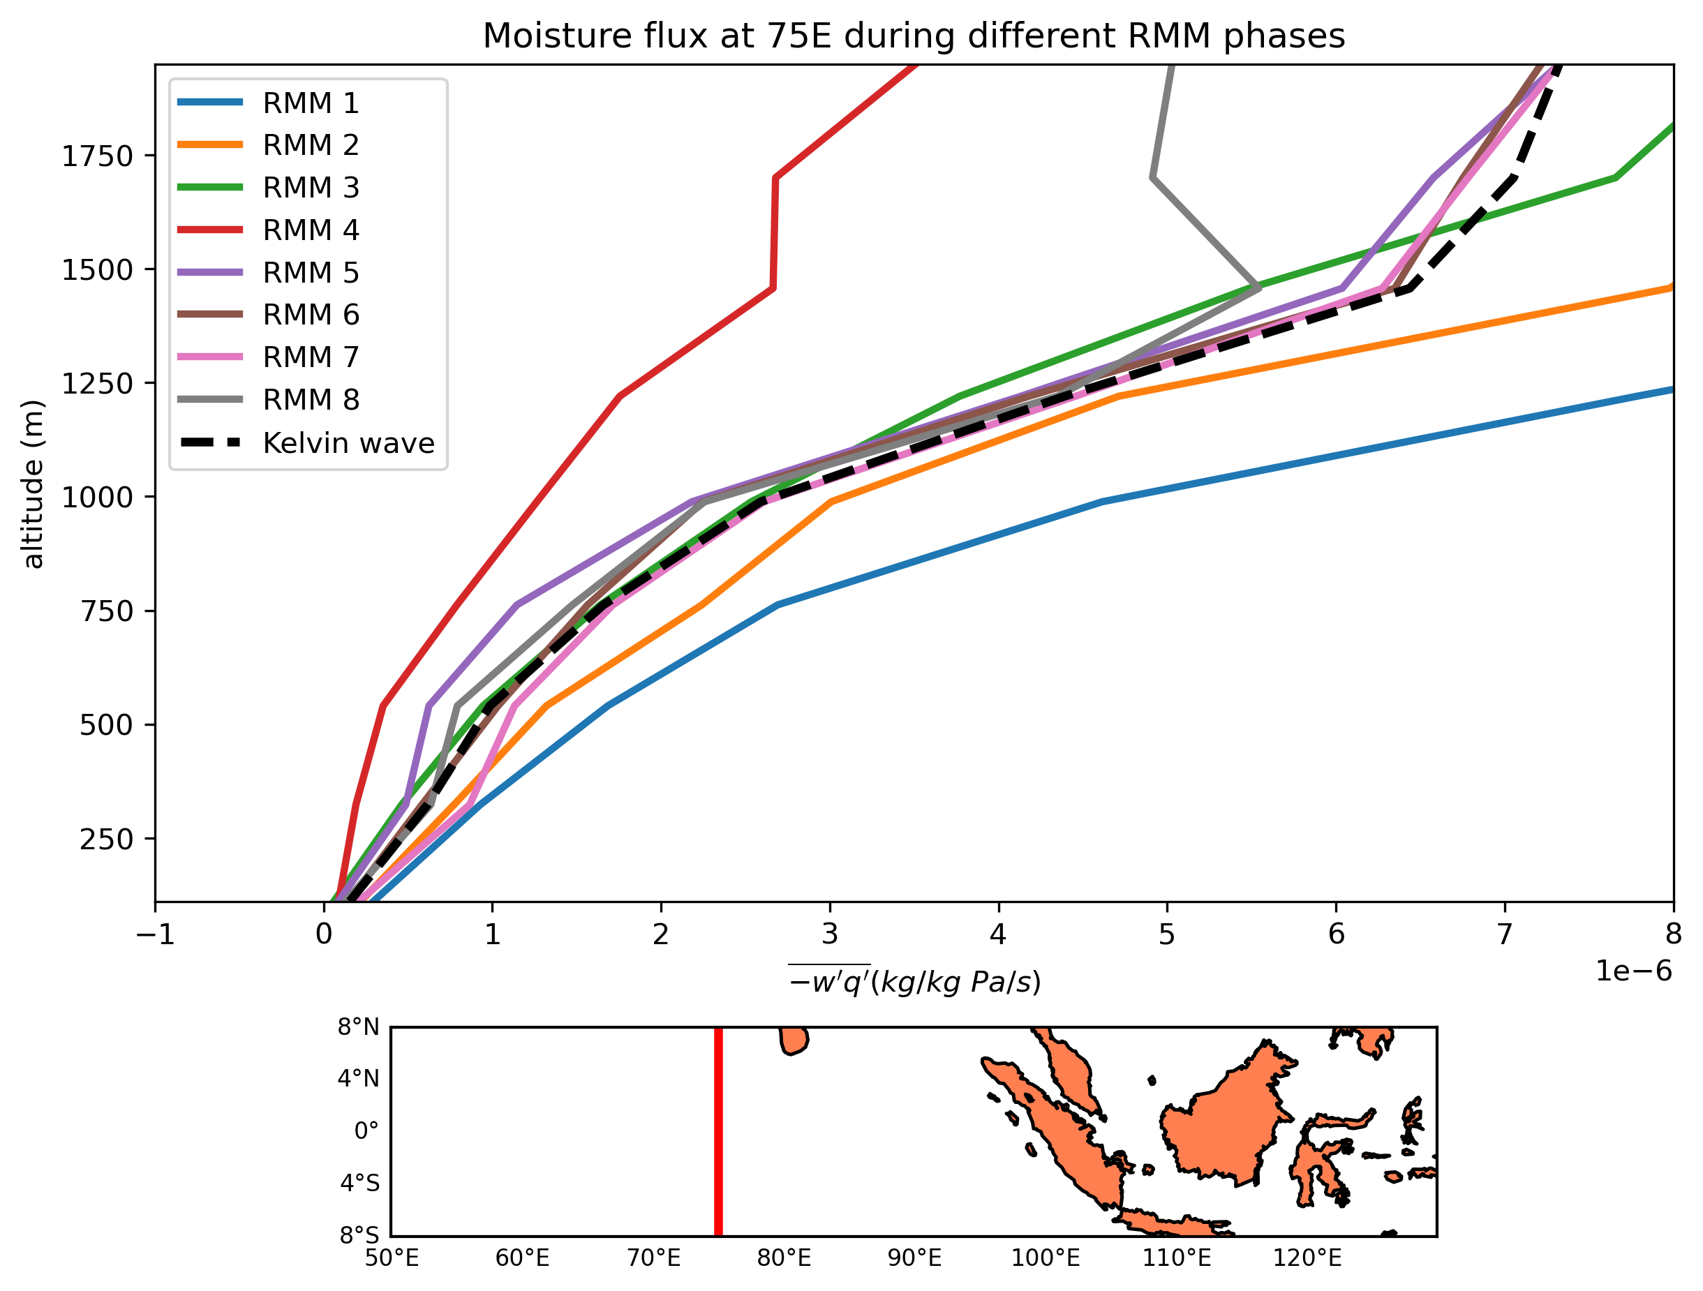
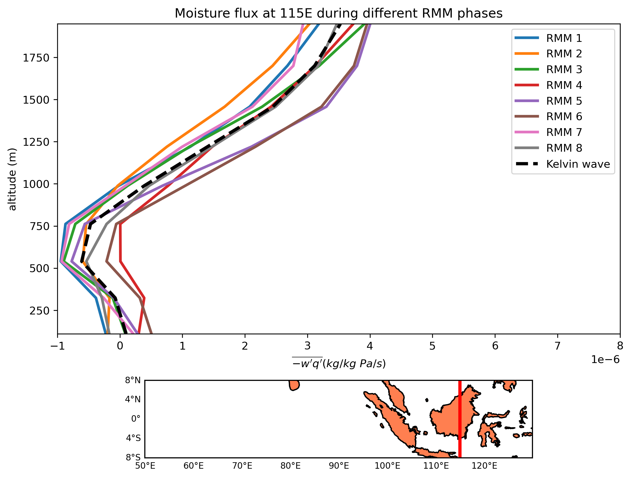
Moisture Flux
Introduction Research Questions Data & Methods Results & Discussions Conclusions
Notes:
Rapidly increases with height over water
Inversion around 500m over land
Increases slower with height over land
Effects of MJO more evident over water than land
Rapid increase during RMM 1 and 2 over water (suppressed convection)

Slide 19
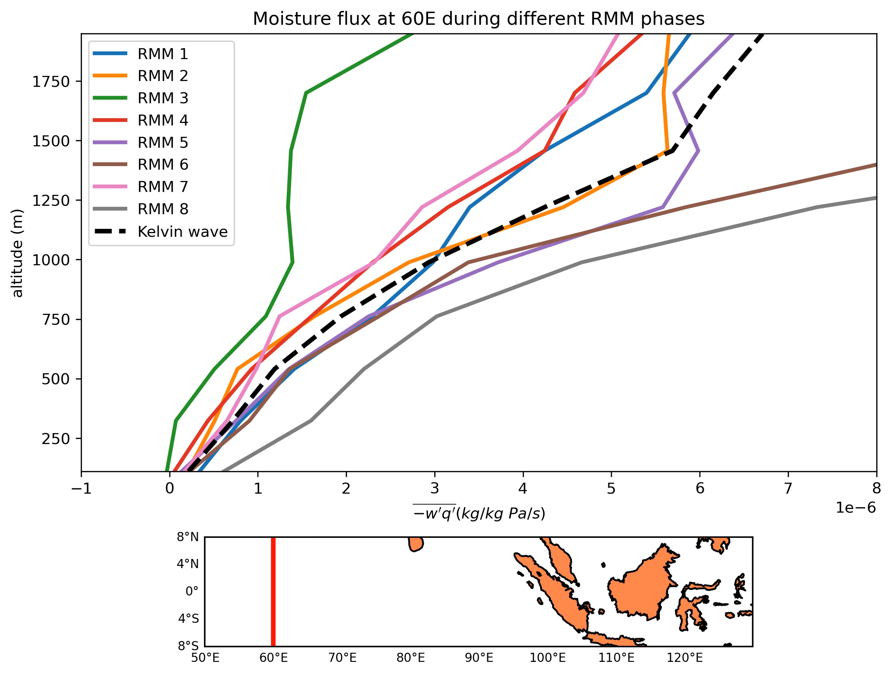
Moisture Flux
The moisture flux rapidly increases with height over water, but inverts over land. Moisture flux increases faster during enhanced MJO convection over water.
Introduction Research Questions Data & Methods Results & Discussions Conclusions

Slide 20
Summary and Conclusions
Get days with a Kelvin wave passing through different base longitudes during different phases of the MJO.
Calculate turbulent flux during each Kelvin wave event.
Momentum flux is more positive over water than land.
The inversion of heat flux occurs at a higher altitude over water than land.
The moisture flux rapidly increases with height over water, but inverts over land.
Effects of MJO more evident over water than land and depends on whether MJO is in its enhanced or suppressed convective phase
Introduction Research Questions Data & Methods Results & Discussions Conclusions

Slide 21
References
Madden, R. A., and P. R. Julian, 1994: Observations of the 40–50-day tropical oscillation—a review. Monthly Weather Review, 122 (5), 814 – 837, https://doi.org/10.1175/1520-0493(1994)122⟨0814:OOTDTO⟩2.0.CO;2.
Roundy, P. E., 2020: Interpretation of the spectrum of eastward-moving tropical convective anomalies. Quarterly Journal of the Royal Meteorological Society, 146 (727), 795–806, https://doi.org/10.1002/qj.3709.
Wallace, J. M., and V. E. Kousky, 1968: Observational evidence of kelvin waves in the tropical stratosphere. Journal of Atmospheric Sciences, 25 (5), 900 – 907, https://doi.org/10.1175/1520-0469(1968)025⟨0900:OEOKWI⟩2.0.CO;2.
Wheeler, M., and G. N. Kiladis, 1999: Convectively coupled equatorial waves: Analysis of clouds and temperature in the wavenumber–frequency domain. Journal of the Atmospheric Sciences, 56 (3), 374 – 399, https://doi.org/10.1175/1520-0469(1999)056⟨0374:CCEWAO⟩2.0.CO;2.
Wheeler, M. C., and H. H. Hendon, 2004: An All-Season Real-Time Multivariate MJO Index: Development of an Index for Monitoring and Prediction. Monthly Weather Review, 132 (8), 1917–1932, https://doi.org/10.1175/1520-0493(2004)132⟨1917:AARMMI⟩2.0.CO;2.
Introduction Research Questions Data & Methods Results & Discussions Conclusions

Slide 22
Summary and Conclusions
Get days with a Kelvin wave passing through different base longitudes during different phases of the MJO.
Calculate turbulent flux during each Kelvin wave event.
Momentum flux is more positive over water than land.
The inversion of heat flux occurs at a higher altitude over water than land.
The heat flux rapidly increases with height over water, but inverts around 500 m over land.
Effects of MJO more evident over water than land and depends on whether MJO is in its enhanced or suppressed convective phase
Introduction Research Questions Data & Methods Results & Discussions Conclusions

